Slide 1
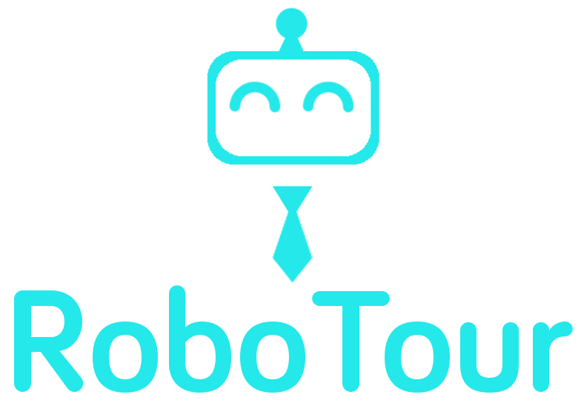
Innovating the museum experience to the 21st century
Notes:
Mahbub

Slide 2



Problem
Language Barriers
Low Revenue Growth
Not enough guides
Notes:
Mahbub
Engage audience
Put you hands up if you have been to a museum in a foreign country and you can’t understand the art descriptions due to limited or no fluency in the local language?
Don’t worry, you are not the only one, many international visitors who come to the UK feels the same way
In the UK, according to Department for Culture, Media and Sport (UK), in the past number of years the number of international visitors have been increasing steadily and now makes up around 50% of total museum visitors. Many of which comes from non-english speaking country with limited or no fluency
According to the Office for National Statistics (UK), the annual revenue of museums has been fluctuating and stagnant in the past 5 years and is expected to be like this.
There are just not enough assistance in the museum at all

Slide 3


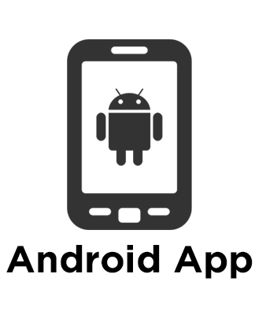
Solution
Engaging
Not so
available
Availability
Not so engaging
Notes:
Mahbub
Audio Guide
Tour Guide
App Guide
RobotTour Guide is the combination of a human guide and an android app, readily available and engaging
Maybe change the X-axis to something else

Slide 4
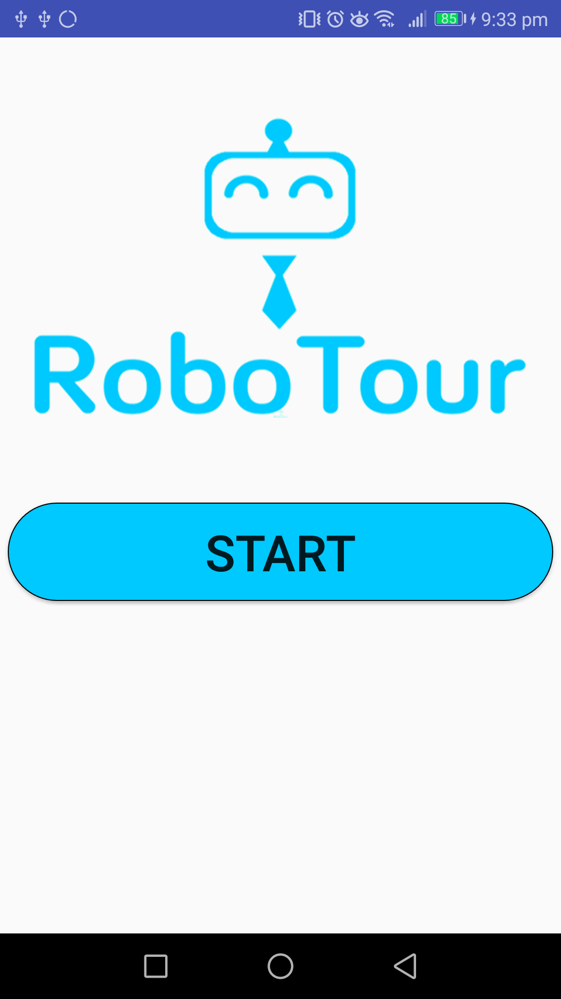
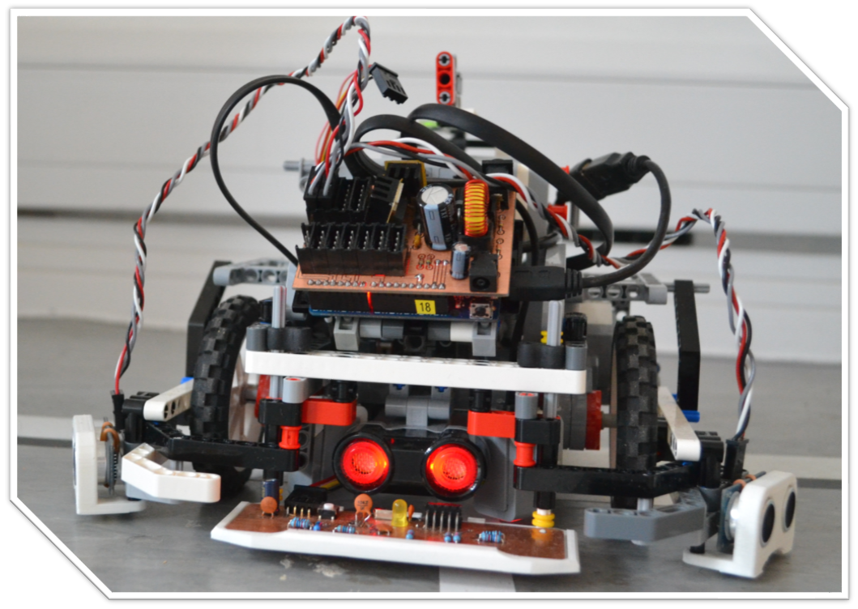
What is
RoboTour?
Notes:
Mahbub
Robotic museum helper
Companion android app

Slide 5



Product
Multi-user
Multi-language
Guide
Audio
Notes:
Mahbub
RoboTour has multi language support cutting down on

Slide 6
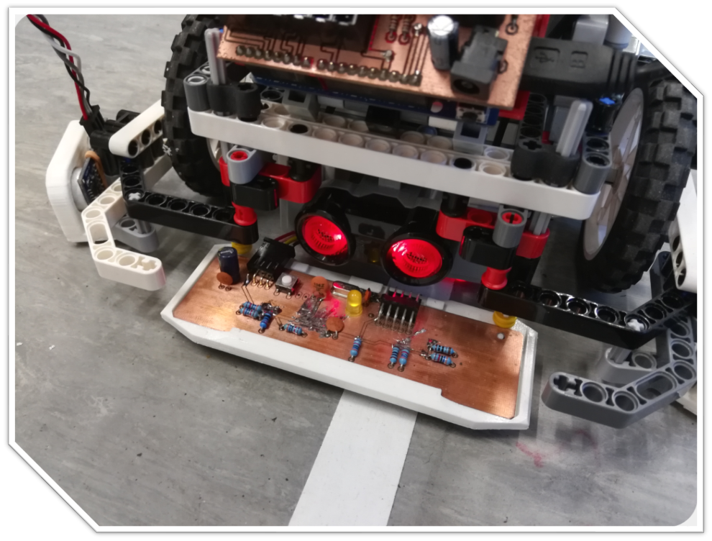
Custom Sensor
Notes:
Michal

Slide 7

Value Proposition
Mobile Donation
Mobile POS Payments Market Worldwide
£9,300bn
2022
5400%
£170bn
2017
Source: Statista
Notes:
Finn
Let’s talk why our customer, the museums, would want RoboTour in their museums. We want to bring innovation to museums and the way they interact with customers and how they donate.
Mobile POS Market Worldwide is extremely attractive (according to statista)
2016 = 240bn$
2022 = 9,300bn$
5400% increase
The future trend of payment is truly cashless and mobile, so will donation we believe. This provides a seamsless integration into cashless donation
With this value proposition and we aim to Increase Revenue by 30%, that’s around £170M. This increase is achieved by
1. Mobile donation
2. Gift shop sales Improvement
3. Globalisation, more international tourists

Slide 8

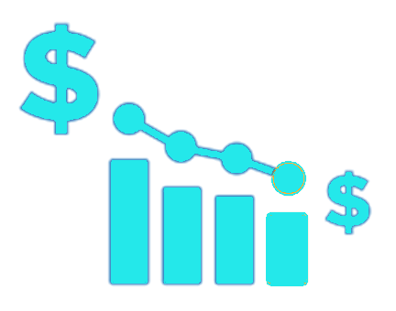
Value Proposition
Increase Revenue
Reduce Labour Cost
Annual revenue of museum in UK (2016)
Average tour guide salary (Indeed.com)
£568M
£18k
£170M
30%
£1k
95%
Source: Office for National Statistics, Statista
Notes:
Finn
Let’s talk why our customer, the museums, would want RoboTour in their museums. We want to bring innovation to museums and the way they interact with customers and how they donate.
Mobile POS Market Worldwide is extremely attractive (according to statista)
2016 = 240bn$
2022 = 9,300bn$
5400% increase
The future trend of payment is truly cashless and mobile, so will donation we believe. This provides a seamsless integration into cashless donation
With this value proposition and we aim to Increase Revenue by 30%, that’s around £170M. This increase is achieved by
1. Mobile donation
2. Gift shop sales Improvement
3. Globalisation, more international tourists

Slide 9



Business Model
Subscription
Gift Shop Ads
£9 Million by Year 6
Notes:
Finn
Our business model is super simple, subscription based model where our partners pay on yearly subscription for each robot. Our app will also provide gift shop ads

Slide 10
Market
& Sales
Ads Revenue/
Museum/Year
£2,000
Key Drivers:
Number of Museums
Subscription fee
Ads Revenue Stream
Robot/Museum
10
Revenue in Year 6
£9M
Subscription/
Robot/Year
£1,000
Market
2,500
Museums
750
Market Share
30%
Source: Museums Association
Notes:
Finn

Slide 11
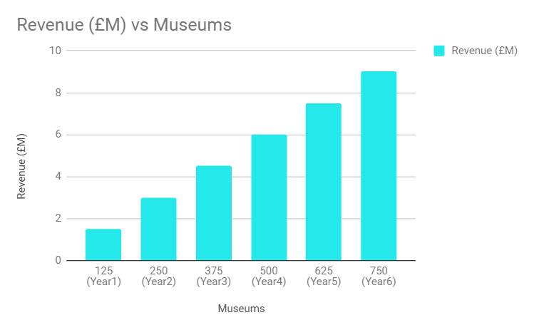
Projections
Notes:
Finn

Slide 12
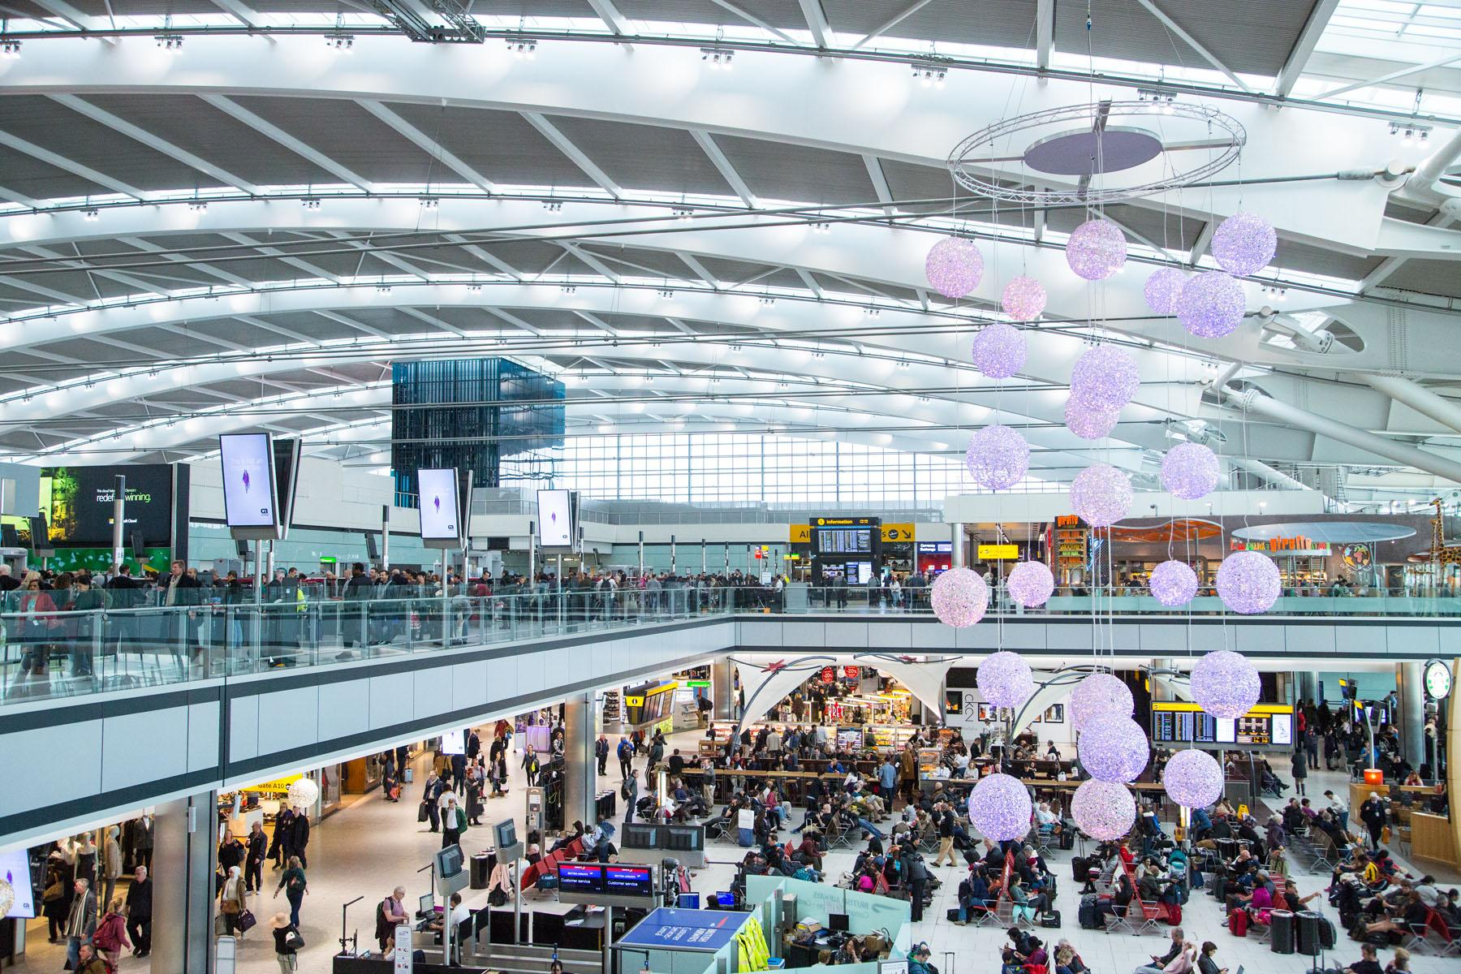
Diversification
Airports
Notes:
Finn

Slide 13
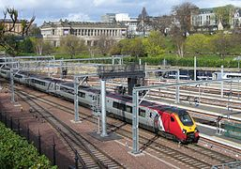
Diversification
Train Stations
Notes:
Finn

Slide 14
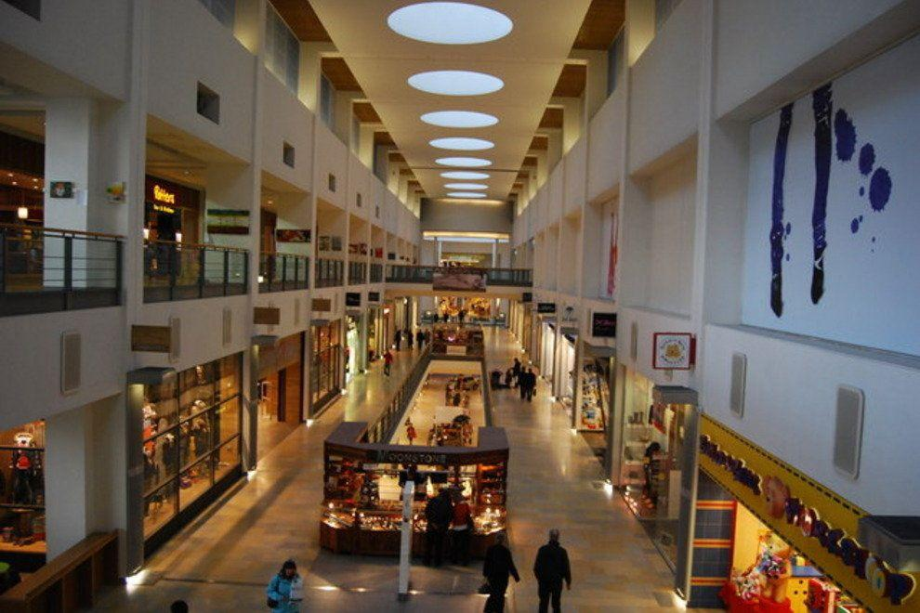
Diversification
Shopping centers
Notes:
Finn

Slide 15
Timeline
Investment & Minimum Viable Product
UK Expansion
2017
2019
2021
Idea Generated
10 Partner Museums in Scotland
World Expansion
2018
2020
Notes:
Finn

Slide 16
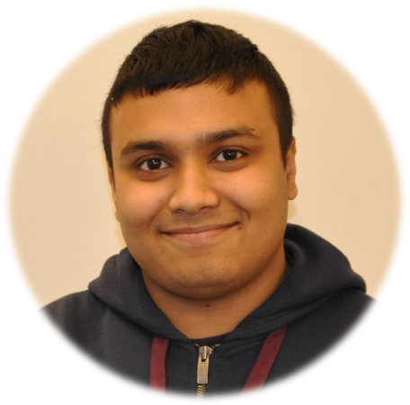
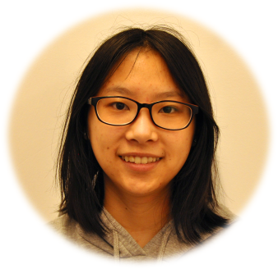
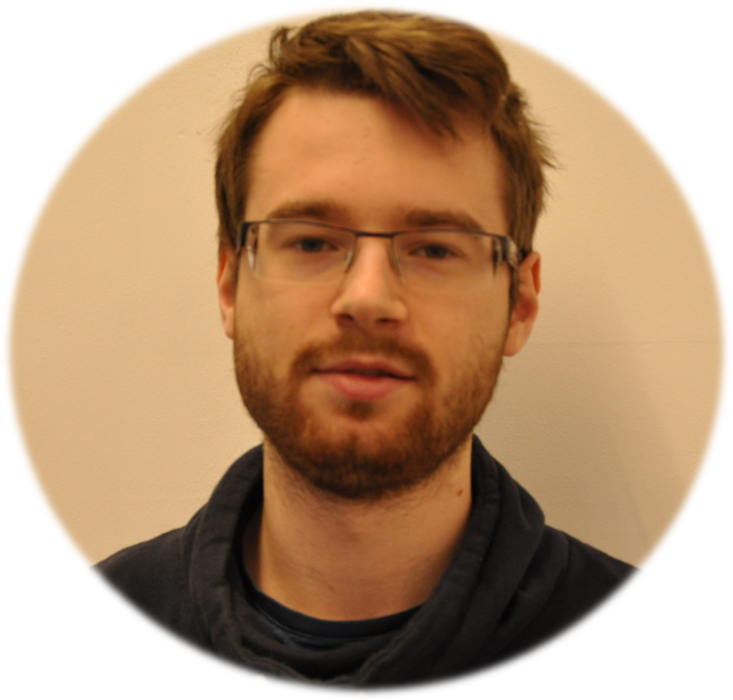
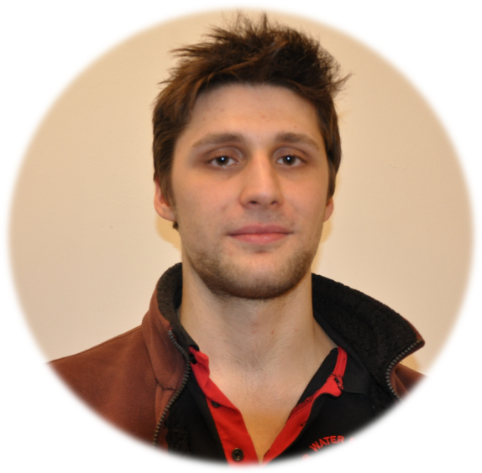
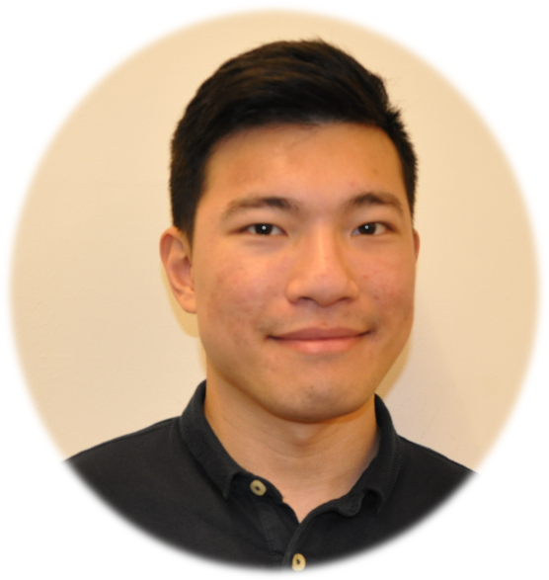
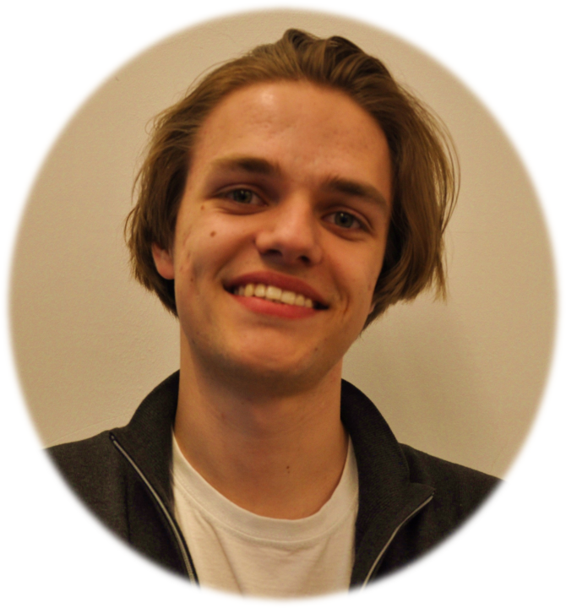
Team
Mahbub Iftekhar
Manager/ Android Developer
Alice Wu
Software Developer
Deividas Lavrik
PID Expert
David Speers
Android Developer/ UI UX
Finn Zhan Chen
Business Analyst
Michal Dauenhauer
Custom Sensor Guru
Notes:
Mahbub

Slide 17
Live
Demo
Notes:
Mahbub

Slide 18
Thank You

